Slide 1
Initial treatment of patients poisoned with industrial toxins
Robert G. Hendrickson, M.D.
Oregon Health and Science University
Portland, Oregon

Slide 2
Objectives
Discuss the treatment of individual patients who are exposed to industrial chemicals
Hospital response to chemical disasters will be discussed in 2 days

Slide 3
Case
Pesticide manufacturing factory – producing chlorpyrifos (an organophosphate pesticide)
Explosion occurs near tank and tank ruptures producing chlorpyrifos vapor and liquid exposure to several workers
Notes:
Chlorpyrifos – organophosphate pesticide

Slide 4
Case
Initial patient is a 33yo man driven to the hospital in a car and dropped at the front door.
He is wet with liquid and has a pungent odor that smells of kerosene.

Slide 5
Case
What do we do?
Decontamination
Initial triage/diagnosis
Initial treatment
Activate disaster plan (more on that on day 3)

Slide 6
Decontamination

Slide 7
Decontamination
Purpose:
To protect health care workers
Basics:
Remove the patients contaminated clothing
Remove the toxin from the patients’ skin

Slide 8
Decontamination
Who requires decontamination?
Exposed to substance that may be harmful to the patient or healthcar workers AND
Exposed to a liquid or vapor
Patients exposed to gases do not require decontamination

Slide 9
Decontamination
In healthcare setting, it is usually not possible to know details of the exposure prior to making the decision
Decontaminate all patients with unknown exposures
If decontamination resources are overwhelmed,
have patients remove clothes/change into clean clothes and wait for decontamination or until more information is available.

Slide 10
Rules of Decontamination
Decon before the patient enters the ED
Decon outside the ED
Must be able to decon walking patients as well as unconscious patients
Rapidly deployable
Preferably male and female areas for walking decontamination
Warm water

Slide 12
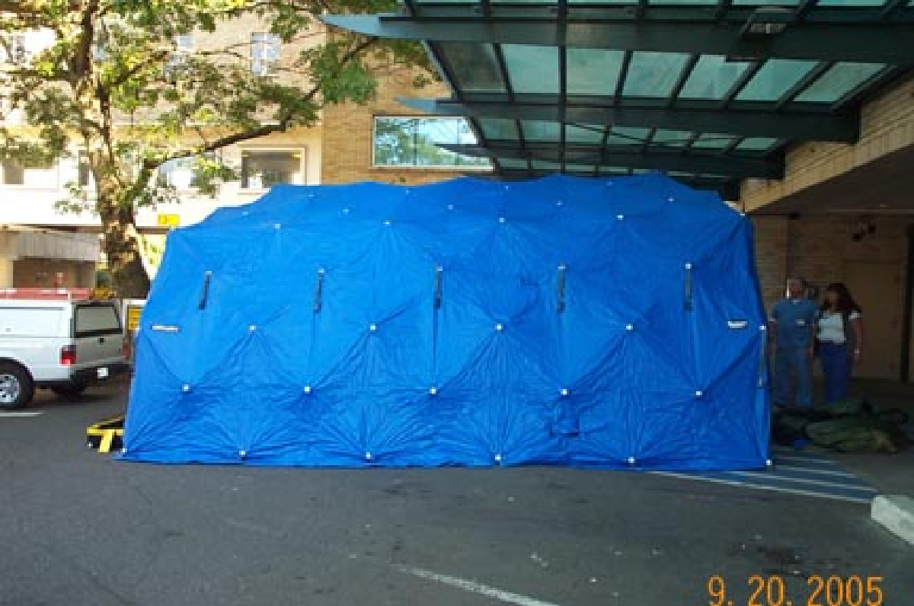

Slide 16
Decon procedure
Resources:
US OSHA best practices for hospital based first receivers of victims from mass casualty incidents involving the release of hazardous substances –
https://www.osha.gov/dts/osta/bestpractices/html/hospital_firstreceivers.html
Houston M, Hendrickson RG. Decontamination. Crit Care Clin 2005; 21: 653-672

Slide 17
Decon procedure
Ambulatory patients:
Ambulatory patient enters private area.
Disrobe and place clothes in labelled bag
Either patient fills out the label or label comes from disaster tags
Discard bag in isolated location
Patient then showers and dries off with a towel.
Towel is also discarded into a bag
Provide patient with clothes
Patients exit decon area and are triaged

Slide 18
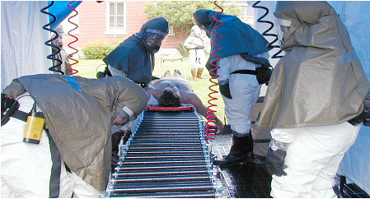
Decon procedure
Non-ambulatory patients
Lay on/brought in on backboard
Backboard rolls on rollerboard
Decontamination personnel remove the patient’s clothing, then use hoses and light brushes/towels to wash the skin
Patient is covered in sheet and brought to the ED for triage

Slide 19
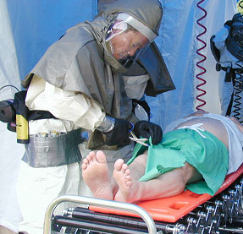
Decon procedure
Removal of clothing may remove the majority of contaminant
Cut & roll clothes
Notes:
Ripping or pulling clothes can aerosolize chemical

Slide 20
How long to wash?
For most cases: 1-2 minutes
Recommendations:
ATSDR, 2-5 min
US OSHA, 5-6 min
US Army Ctr Prev Med, 1 min
US Army Decon Research Team, 2-3 min
Notes:
Chppm – center for health promotion and preventive medicine
SBCCMCDRT – Soldier and biologic chemical command’s mass casualty decontamination research team

Slide 21
How long to wash?
For most cases: 1-2 minutes
Studies:
10 pts had complete removal of PCBs and pesticides after 3 min decon (Vet Hum Tox 1992; 34: 61-4)
Pesticide absorption decreased by 2 min decon (decon 15 min after application):
Azodrin, 15% to 2%
Parathion 36% go 7%
Lindane 9% to 2%
Chemical simulants removed by 3-6 min decon
Sarin (ethyl lactate), sulfur mustard (methyl salicylate)
Notes:
Chppm – center for health promotion and preventive medicine
SBCCMCDRT – Soldier and biologic chemical command’s mass casualty decontamination research team

Slide 22
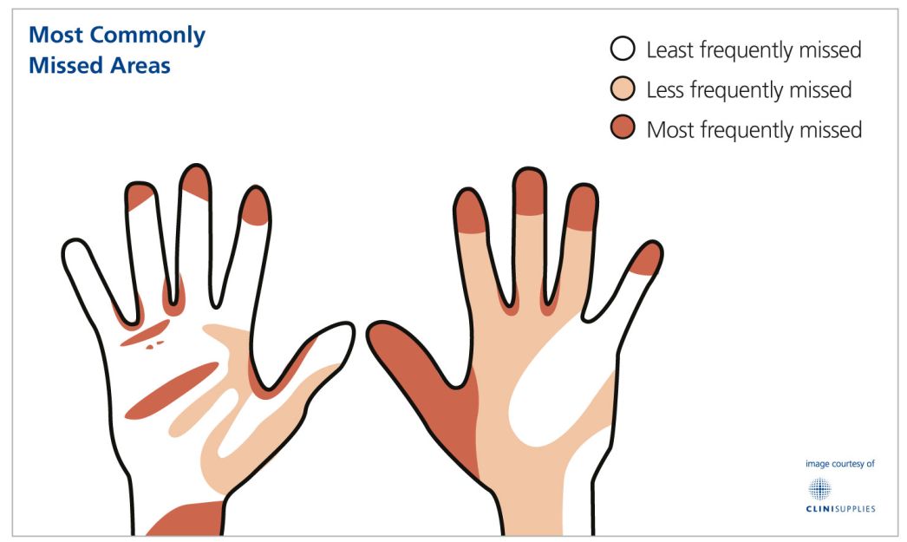
Decon procedure
What areas are typically missed by decontamination:
Axilla
Groin
Bottom of feet

Slide 23
What solution do we use?
Water
Goal of hospital decontamination is physical removal of agent
Reactions with water (lithium, metallic sodium, potassium, cesium, and rubidium)
Bleach - dilute solution (0.5%)
Hydrolysis and oxidation requires contact time
Recommended by many militaries
Not necessary in hospitals for decon
May act to break down chemical in runoff

Slide 24
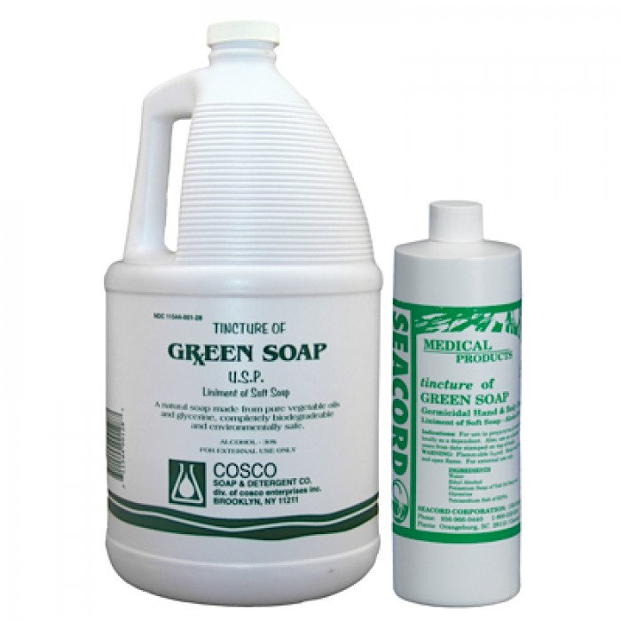
What solution do we use?
Soap
Green soap (alkaline soap) – may add some chemical hydrolysis of water runoff
Any soap will do
Main advantage:
Reminds patients to physically wipe all areas, including areas that are typically missed (groin, axilla, hair, feet)

Slide 26
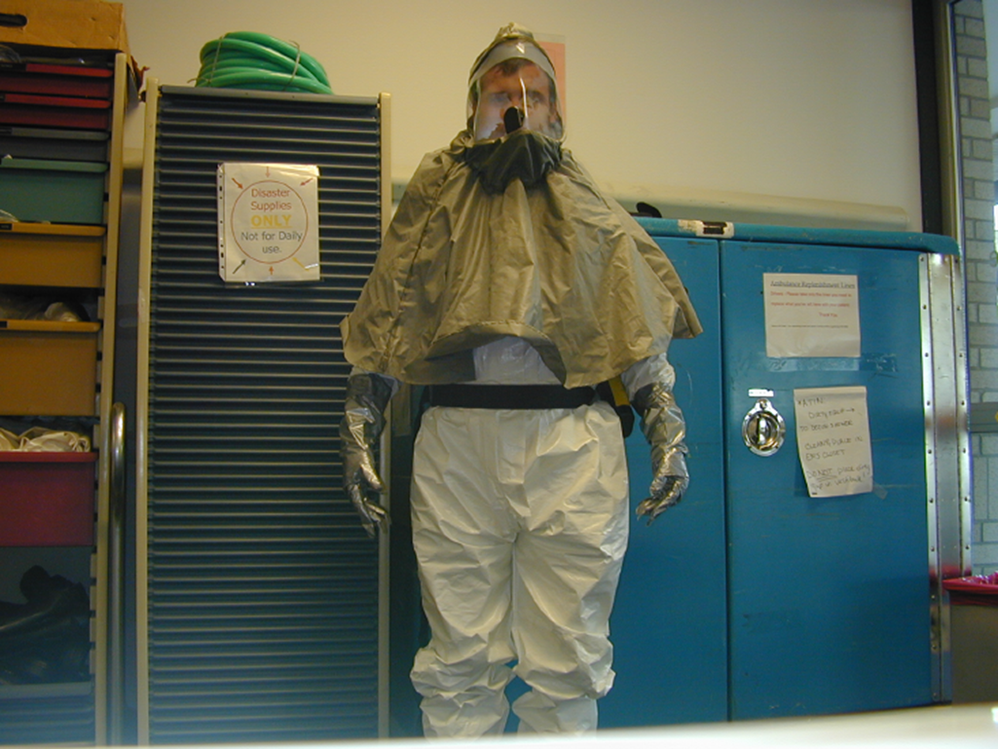
Prêt-à-Porter?
Personal Protective Equipment for hospital decontamination

Slide 27
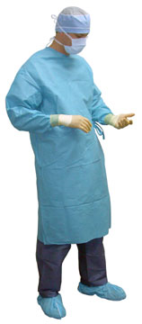
Personal protective equipment (PPE)
Level D – minimal protection
Used for “nuisance contamination”
Same as performing a bloody procedure
“work clothes”
Coveralls, boots.
Optional – hard hat, face shield, gloves, goggles/safety glasses

Slide 28
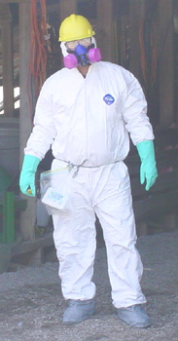
Personal protective equipment (PPE)
Level C
Intended for splash protection with some protection from vapors
Equipment:
Air purifying respirators
Chemical resistant clothing that covers the body: Hooded, chemical-resistant suit, boots, gloves

Slide 29
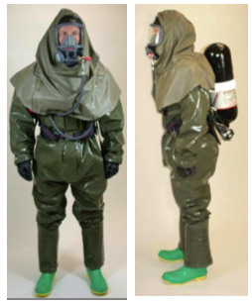
Personal protective equipment (PPE)
Level B –
Higher level of respiratory protection than level C
Used when respiratory protection is absolutely necessary, but skin/eye protection may not be a priority
E.g. oxygen poor environments, when chemical has known concentration, radioisotopes, when mobility is important (compared to level A).
Equipment:
Positive pressure, full facemask SCBA or SAR (supplied air respirator)
Chemical-resistant clothing: suit, gloves, boots
Notes:
Generally used when the concentration of airborne toxin are known and are primarily a threat through respiration, not skin contact.

Slide 30
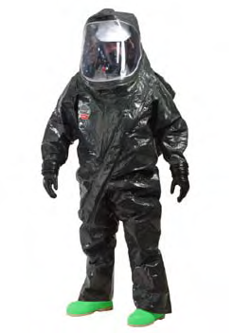
Personal protective equipment (PPE)
Level A – fully encapsulated – full protection from all gases – meant for use in a “hot zone”
Equipment:
SCBA or SAR
Fully-encapsulated chemical protective suit, gloves, and boots

Slide 31
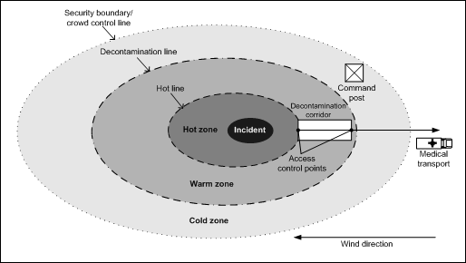
Decontamination setup
Traditional decontamination area setup:

Slide 32
Decontamination setup
Traditional decontamination area setup:
Hot zone
High concentration of chemical, Level A

Slide 33
Decontamination setup
Traditional decontamination area setup:
Warm zone
Decontamination area, lower concentration of chemical

Slide 34
Decontamination setup
Traditional decontamination area setup:
Cold zone
“clean area”, very low concentration of chemical

Slide 35
Hospital decontamination setup
Traditional hospital decontamination area is set up with a warm zone where initial triage is performed, a decontamination zone, and a treatment zone

Slide 36
Patient flow
WARM ZONE
WARM ZONE
Initial Triage
Decontamination tent
COLD ZONE
COLD ZONE
Treatment Zone

Slide 37
Initial triage
An initial triage officer is placed outside of the decontamination facility
Level B/C PPE
Their main role is to provide direction to ambulatory patients and direct flow into the decontamination unit
It is exceedingly difficult and not likely helpful to perform treatment in the warm zone outside of the decontamination tent

Slide 38
Patient flow
WARM ZONE
WARM ZONE
Initial Triage
Decontamination tent
COLD ZONE
COLD ZONE
Treatment Zone

Slide 39
Decontamination personnel
Decontamination personnel direct ambulatory patients through the steps of decontamination and provide decontamination to non-ambulatory patients
Wear Level B/C PPE

Slide 40
Patient flow
WARM ZONE
WARM ZONE
Initial Triage
Decontamination tent
COLD ZONE
COLD ZONE
Treatment Zone

Slide 41
Triage personnel
Triage personnel are positioned on the “cold side” of the decontamination tent.
Wear level D PPE
Roles:
Triage
Initial therapy

Slide 42
Patient flow
WARM ZONE
WARM ZONE
Initial Triage
Decontamination tent
COLD ZONE
COLD ZONE
Treatment Zone

Slide 43
Training
Specific and regular training is necessary for anyone putting up a decontamination tent and for anyone donning Level B or C gear to perform decontamination.

Slide 44
Video – donning PPE for decon

Slide 45
Video – donning PPE for decon
https://www.youtube.com/watch?feature=player_detailpage&v=L6fsYcTgeB0

Slide 46
Video – doffing PPE for decon

Slide 47
Video – doffing PPE for decon
https://www.youtube.com/watch?feature=player_detailpage&v=2Oi5_NKObZc

Slide 48
Initial therapy
Initial therapy:
Generally performed in the triage area (cold zone)
Decision to initiate therapy:
Known substance
Symptoms that fit a specific toxicologic syndrome
Most chemicals are treated with decontamination and supportive care

Slide 49
Initial therapy
Initial therapy:
Intubate in tent or triage area?
For most patients, care will be better waiting 60 seconds until they are in the ER
Triage area:
Gauze for direct pressure of wounds
Bag valve mask
Oxygen cylinders
? benzodiazepines to stop seizures ?

Slide 50
Immediate antidotes
Organophosphate pesticides:
Atropine 2mg IM, double every 3-5min
Reactivating agent:
Pralidoxime, obidoxime, HI-6, etc
Cyanides
Amyl nitrite
Thiosulfate and hydroxycobalamin – IV infusions
In most cases, these are not necessary in the tent or triage area – they can be given in the ED

Slide 51
Case
Man exposed to liquid and vapor chlorpyrifos (an organophosphate pesticide)
Clothes are wet with liquid
Unconscious
Salivating, lacrimating, sweaty, vomiting, diarrhea, fasciculations, and muscle weakness (consistent with chlorpyrifos toxicity)

Slide 52
Case
Decontaminate?
Treatment?
Atropine
Reactivating agent
Diazepam
Triage

Slide 53
Quiz
What is the PRIMARY purpose of decontaminating patients at the hospital?
A. To decrease their absorption of the chemical
B. Protect health care workers
C. It is fun to splash around in the water

Slide 54
Quiz
What is the PRIMARY purpose of decontaminating patients at the hospital?
A. To decrease their absorption of the chemical
B. Protect health care workers
C. It is fun to splash around in the water

Slide 55
Quiz
MOST of the chemical can be removed with what action?
A. Scrubbing the skin with abrading material
B. Removing the clothing
C. 20 minutes of decontamination with cold water

Slide 56
Quiz
MOST of the chemical can be removed with what action?
A. Scrubbing the skin with abrading material
B. Removing the clothing
C. 20 minutes of decontamination with cold water

Slide 57
Quiz
What is the primary danger of NOT decontaminating a patient who is contaminated with an organophosphate pesticide?
A. Healthcare workers may develop symptoms and not be able to help others
B. The smell is disgusting
C. Continued absorption of the chemical

Slide 58
Quiz
What is the primary danger of NOT decontaminating a patient who is contaminated with an organophosphate pesticide?
A. Healthcare workers may develop symptoms and not be able to help others
B. The smell is disgusting
C. Continued absorption of the chemical

Slide 59
Quiz
Which level of PPE protects against splashes and some vapors and has a filtered air purifying respirator?
Level A
Level B
Level C
Level D

Slide 60
Quiz
Which level of PPE protects against splashes and some vapors and has a filtered air purifying respirator?
Level A
Level B
Level C
Level D

Slide 61
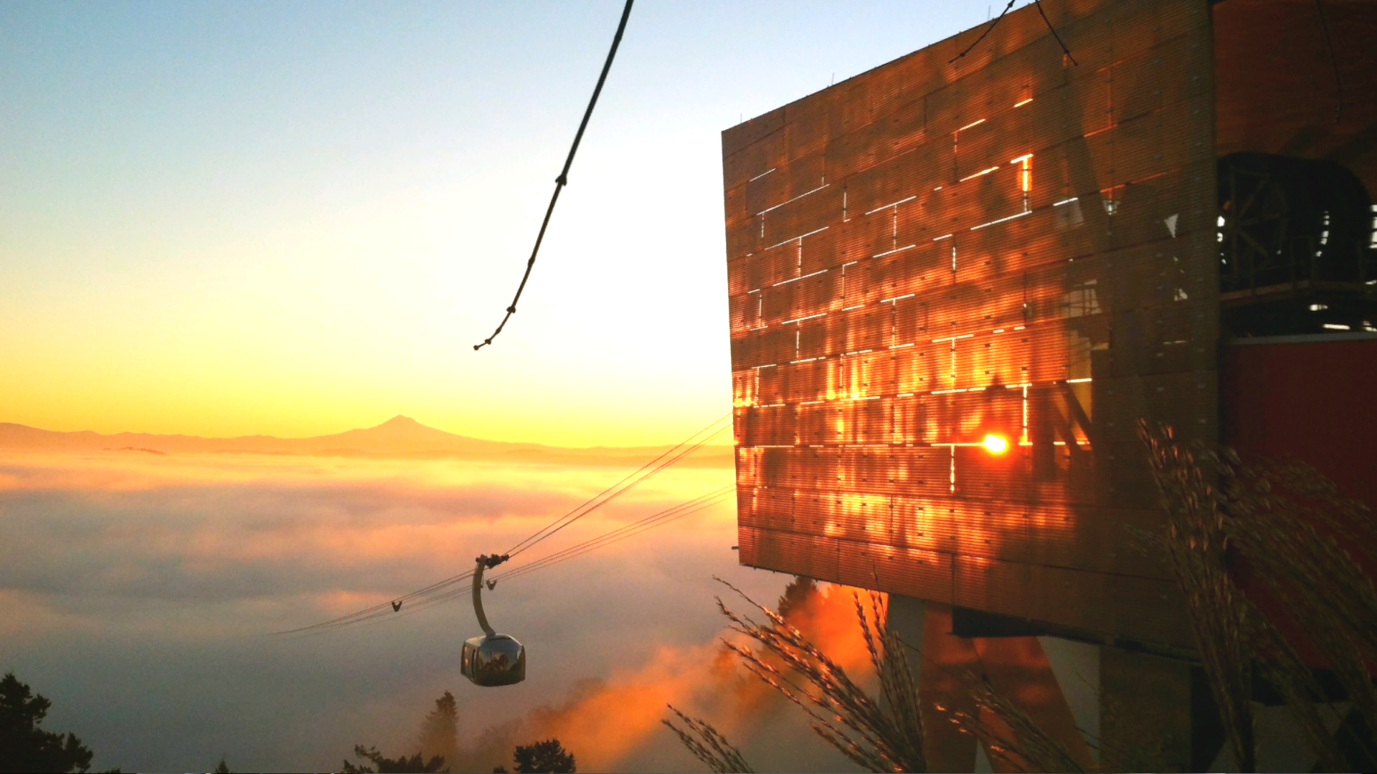
Questions and discussion…

